Slide 1
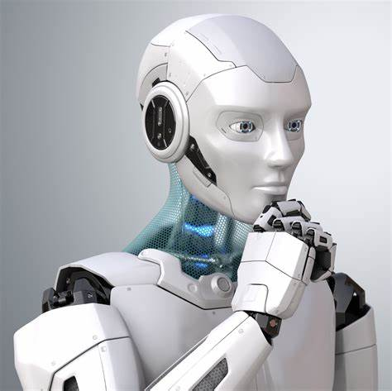

A Level Computer Science
Transition Work
Any problems or help, please feel free to email me at any point throughout the summer
Mr Cottee – jcottee@rushcliffespencer.org.uk

Slide 2
Task 1 - “Tell me about yourself”
1
Why did you choose Computer Science?
Expected time to complete: ½ hour
In this simple task you get the opportunity to tell me your choices and reasons behind choosing to study Computer Science. Please answer all questions as best you can.
1. Why did you choose to study A level Computer Science?
2. What other courses have you chosen to study at Key Stage 5, and what made you choose this combination?
3. What are you hoping to achieve from studying Computer Science?
4. How would you describe yourself as a learner at GCSE? What skills where you good at, what areas would you like to improve on / need support with?
5. What are your other hobbies and interests outside of school? Anything related to Computing?

Slide 3
Task 2 - Independent research task
2
Emerging computer technology
Expected time to complete: 2 hours
In this task you get to investigate any area of emerging computer technology which interests you.
You can pick any area which interests you, but examples could be:
Artificial intelligence
Robotics
Automated self driving cards
Quantum computing
In no more than ONE side of A4 summarise the area you have chosen under the following four headings:
What is it?
What are the possible Social, Moral, Cultural and Ethical benefits of this technology on society
What are the possible Social, Moral, Cultural and Ethical risks of this technology on society
My conclusion on this technology and what it will mean for our world 10 years from now
Additional help:
For additional help and support in structuring your answer you might like to watch some of the videos from the following Craig ‘n’ Dave playlists:
OCR:
SLR 17 – Ethical, morale and cultural issues
https://student.craigndave.org/videos/slr-17-ethical-moral-and-cultural-issues

Slide 4
Task 2 - Independent research task answer
2
Expected time to complete: 2 hours
Space to present your answer to the previous slide, in any way you wish

Slide 5
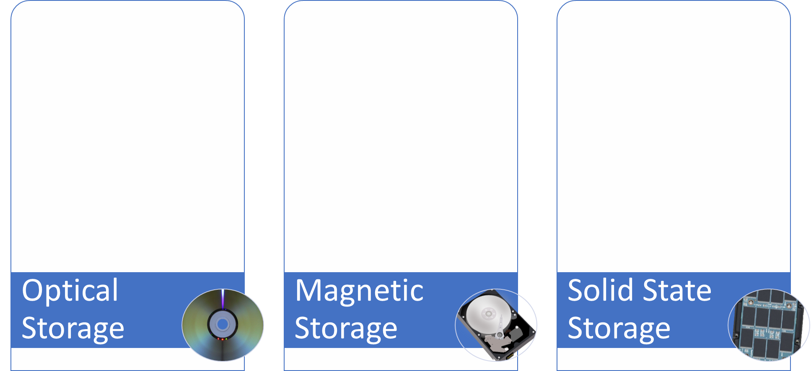
Task 3 – Types of Secondary Storage
3
Types of secondary storage
Expected time to complete: 1 hour
How does it work?
How does it work?
How does it work?
Enter your answer here…
Enter your answer here…
Enter your answer here…
Advantages / Positives
Advantages / Positives
Advantages / Positives
Enter your answer here…
Enter your answer here…
Enter your answer here…
Disadvantages / Negatives
Disadvantages / Negatives
Disadvantages / Negatives
Enter your answer here…
Enter your answer here…
Enter your answer here…
Examples of typical usage
Examples of typical usage
Examples of typical usage
Enter your answer here…
Enter your answer here…
Enter your answer here…
Typical storage capacity range
Typical storage capacity range
Typical storage capacity range
Enter your answer here…
Enter your answer here…
Enter your answer here…

Slide 6
Task 4 - Linear search programming task
4
Algorithms: from theory to practice
Expected time to complete: 2 hours
Have a go at coding the linear searching algorithm in a programming language of your choice.
The program should work use an array called items which is pre-populated with the following values: "Florida","Georgia","Delaware","Alabama","California“
The program should ask the user to “Enter the state to find:”
If the program locates the state entered by the user in the array it should report back to the screen “Item found at position n”
If the program can not locate the state entered by the user in the array it should report back to the screen “Item not found”
Cut and paste the code you have written into the box below:

Slide 7
Task 5 – Guessing game programming task
5
Algorithms: from theory to practice
Expected time to complete: 2 hours
Create a program that generates four random numbers between 0 and 9.
The user must guess the four-digit combination.
Provide the user with a limited number of guesses (e.g., 7).
After each guess, display which numbers are correct and in the correct position.
For example, if the program generates the sequence 1 2 3 4, and the user guesses 7 5 3 2, the program should display **3*.
Extension: Can you make it like wordle? When it tells you if it’s correct but in the wrong place?
Cut and paste the code you have written into the box below:

Slide 8

Programming Extension Tasks – For those that want some more ☺
1. Prime Number Checker:
  Write a program that checks if a given positive integer is a prime number.
  Allow the user to input a number.
  Determine whether it’s prime or not.
  Extensions:
    Display all prime numbers within a given range.
    Optimize the primality check algorithm.
2. Palindrome Detector:
  Create a program that checks if a given string is a palindrome (reads the same forwards and backwards).
  Allow the user to input a word or phrase.
  Verify if it’s a palindrome.
  Extensions:
    Ignore spaces and punctuation.
    Handle case-insensitive palindromes.
3. Hangman Game:
  Implement a simple Hangman game.
  Choose a random word from a predefined list.
  Allow the user to guess letters.
  Display the partially revealed word and track incorrect guesses.
  Extensions:
    Add a graphical interface. (TKInter might be a good idea)
    Include different word categories (e.g., animals, countries).

Slide 9
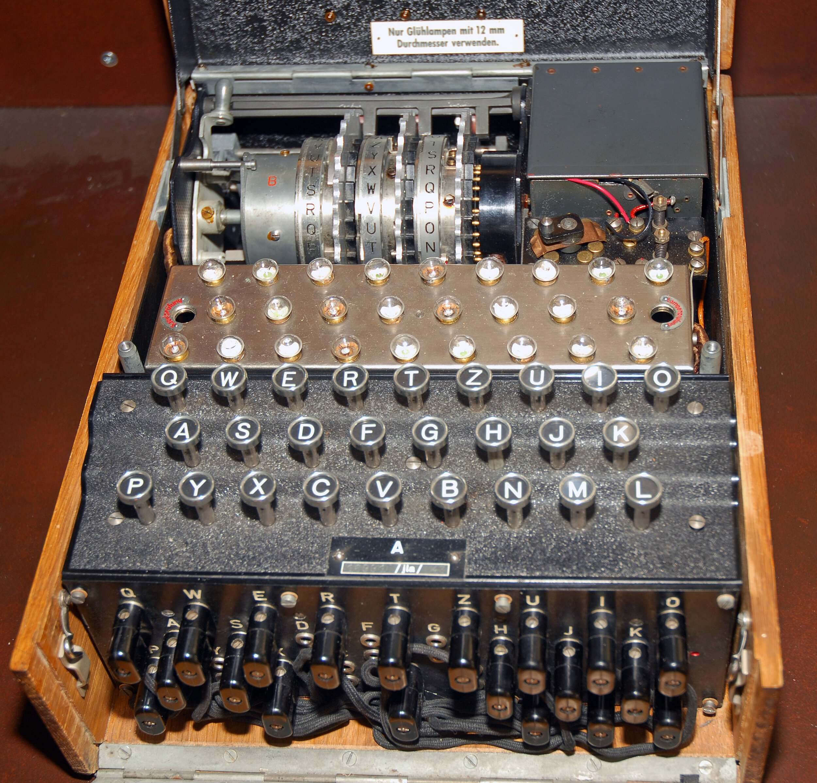
Programming Extension Tasks – For those that want some more ☺
4. Student Grade Tracker:
  Create a program that allows teachers to input student names and their test scores.
  Calculate the average score for each student.
  Display the student names along with their average scores.
  Extensions:
    Sort students based on their average scores.
    Add functionality to update scores.
5. File Encryption/Decryption:
  Develop a program that encrypts and decrypts text files.
  Use a simple encryption algorithm (e.g., Caesar cipher).
  Allow the user to choose between encryption and decryption.
  Extensions:
    Implement more robust encryption methods.
    Handle binary files.

